Slide 1
Introduction to Machine Learning on Apache Spark 04 | Machine Learning with R Server on HDInsight
Richard Conway | Azure Most Valuable Professional, Elastacloud

Slide 2
What is R? Why use R?
Deploying R Server on HDInsight and Spark
R Server and ScaleR
Using client tools to connect
Summary Statistics with R Server
File System and Map Reduce with R Server
Preparing data at scale
Rx functions and Machine Learning
Conclusion

Slide 3
What is R?

Slide 4
Free and open source programming language and software environment
Built by statisticians
Capable of running on multiple operating systems
Can be extended with new packages
Graphical capabilities for data analysis
Scripting language with good IDE support
Built for data manipulation

Slide 5
Why use R?

Slide 6
Extensible, can write your own module
Large community of R programmers
For statistical computing and data mining and machine learning
Thousands of algorithmic packages
Graphical capabilities for data analysis
> data <- read.csv(“iris.csv”)
> plot(data)

Slide 7
Manipulating data and deriving statistics in R
DEMO
Notes:
Simple R script:
Use CRAN and library packages
Show summary statistics and normal distributions in R

Slide 8
Deploying R Server on Spark

Slide 9

Run R on multiple cores
Run R on multiple computers
Efficient parallelization of statistical and data-mining algorithms
Read big data at scale – WASB, Hadoop HDFS, Hive, SQL ODBC
Store data at scale
> mySC <- RxSpark(consoleOutput=TRUE)
> rxSetComputeContext(mySC)

Slide 10
R Server on Spark deployment
DEMO

Slide 11
R Server and ScaleR

Slide 12
R runs on a single thread
R runs on a single core
Loading data can take a while!
R can run out of memory easily
Graphical capabilities for data analysis
Scripting language with good IDE support
Built for data manipulation

Slide 13
R Server
ConnectR
Access data from a variety of data sources
Reduce ETL development
Access data from legacy analytics tools such as SAS and SPSS
Data
ScaleR
Transparent parallelization of computations and data analysis
Data preparation, statistics, predictive modelling and machine learning algorithms
No memory barriers
Requests
Resources
DistributedR
Parallel compute framework managing resources
Run on multiple architectures
Consistent behaviour between platforms

Slide 14
ScaleR function examples

Slide 15
ScaleR cov function. Returns the covariance matrix
rxCov(~ sepallength + sepalwidth + petallength + petalwidth, data=irisDS)
ScaleR lm function. Fits a linear model to data
rxLinMod(petalwidth ~ petallength, data = irisDS)$coefficients
ScaleR glm function. Fits a linear regression model to data
rxLogit(sepallength ~ class, data = irisDS)

Slide 16
ScaleR plot function. Creates a line plot from data
rxLinePlot(sepallength ~ sepalwidth, groups = class, data = irisDS)
ScaleR cluster::kmeans() function. Performs K-means clustering rxKmeans(~sepallength + sepalwidth + petallength, data = irisDS, numClusters = 3, seed = 30)
Run arbitrary R function in parallel rxExec(…)

Slide 17
Running Scale functions with R Server
DEMO

Slide 18
Visual Studio for R and R-Studio

Slide 19
Visual Studio
Only runs on Windows. No Linux versions
Some editions have to be purchased
Can’t currently connect to R-Server
R interactive window
IntelliSense
Multithreaded for increased computational performance
> irisData = read.table("iris-multiclass.csv", sep = ",")
> Summary(irisData)

Slide 20
R-Studio
Free to use on all platforms
Web version connects to R-Server
Paid support available
Single thread
Single core
Intellisense
R interactive window
> install.packages("ggplot2")
> library(ggplot2)

Slide 21
R for Visual Studio
DEMO

Slide 22
Summary statistics with R Server

Slide 23
Rx Summary functions
Scalable rxSummary function
rxCrossTabs and rxCube functions
rxCor and rxCov functions
Helper functions for data inspection including rxGetInfo, rxGetVarInfo, rxGetVarNames
> rxSummary(irisData)
> rxGetInfo(irisData) > rxCrossTabs(petallength ~ class, data = irisDS)

Slide 24
Correlation and Covariance in R
set.seed(5)
x <- seq(1, 100) + (8.0 * rnorm(1:100))
set.seed(7)
y <- seq(1, 100) + (8.0 * rnorm(1:100))
plot(x, y)
cov(x, y)
cor(x, y)
Notes:
Using correlation and covariance you can get the numbers back which will tell you the correlation and covariance of two series
In this way can take data and check this in R and all gets calculated locally

Slide 25
Correlation and Covariance in R Server
df <- data.frame(x, y)
rxCov(formula = ~ x + y, df)
Rows Read: 100, Total Rows Processed: 100, Total Chunk Time: 0.275 seconds
Computation time: 0.882 seconds.
x y
x 898.0958 797.6942
y 797.6942 828.1861
rxCor(formula = ~ x + y, df)
Rows Read: 100, Total Rows Processed: 100, Total Chunk Time: 0.001 seconds
Computation time: 0.242 seconds.
x y
x 1.0000000 0.9249348
y 0.9249348 1.0000000
Notes:
With the usage of rxCor and Cov we can inspect a data frame or imported data and compute this across the cluster
This will mean that we can run a matrix of any of the columns rather than just two and show the directional correlation so multiple columns and correlations

Slide 26
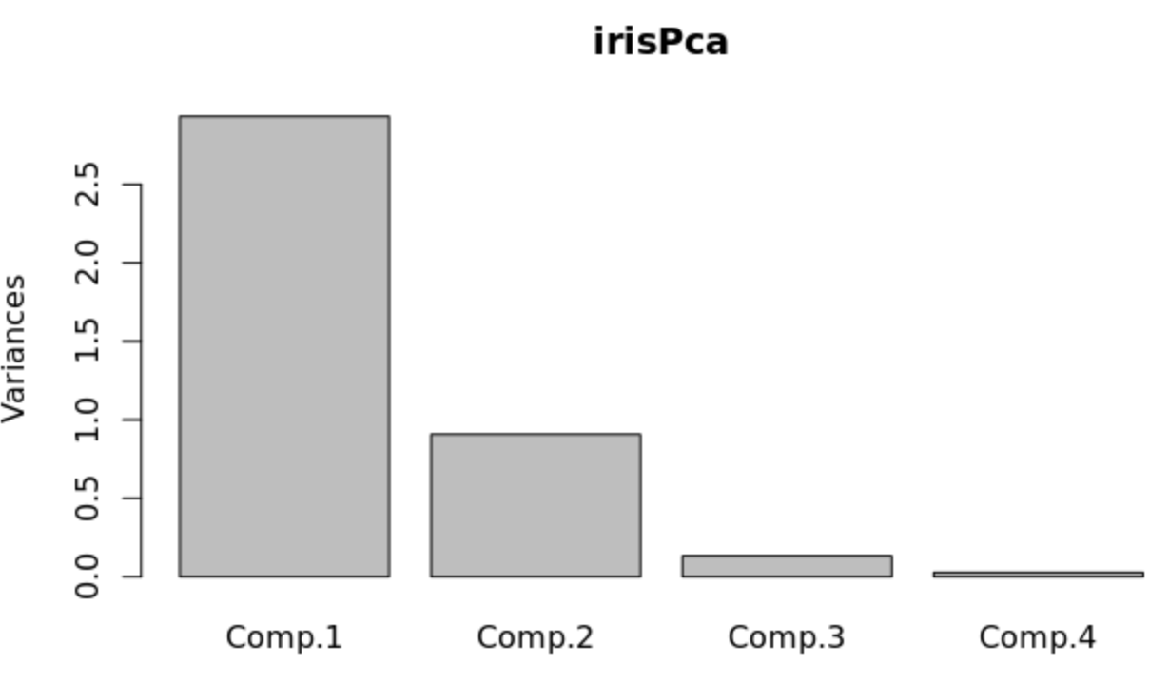
Calculating Principal Components
irisCov <- rxCov(~ Sepal.Length + Sepal.Width + Petal.Length + Petal.Width, data=irisLog)
irisPca <- princomp(covmat=irisCov, cor=TRUE)
summary(irisPca)
plot(irisPca)

Slide 27





Categorical Variables
moviesDf <- rxImport(inData = movies)
df <- rxFactors(inData = moviesDf, overwrite = TRUE, factorInfo = list(Ratings = list(levels = c(Bad = 1, NotSoBad = 2, Average = 3, VeryGood = 4, Great = 5), varName = "Rating")))
Notes:
Categorical variables are used when there are discrete values
In this case the values are numeric which can be categories as well as text

Slide 28
Exporting models
Models can be exported into a neutral XML format
Format is called PMML (Predictive Model Markup Language)
Need to convert Rx Models into R models prior to export
Can export models into Apache Spark and other frameworks
library(pmml)
pmml(as.lm(rxLinModObj))
Notes:
Use the princomp function to pass a covariance matrix – this is the part that can be scaled

Slide 29
Summary statistics with R server
DEMO

Slide 30
Investigating the file system with R Server

Slide 31
To download files to Windows Azure Blob Storage (WASB)
> sourceDir <- “iris" > remoteDir <- "https://archive.ics.uci.edu/ml/machine-learning-databases/iris"
> dir.create(source)
> download.file(file.path(remoteDir, "iris.data"), file.path(source, "iris-multiclass.csv"))
> bigDataDirRoot <- "/"
> rxHadoopMakeDir(bigDataDirRoot)
> rxHadoopCopyFromLocal(source, bigDataDirRoot)
Temp local directory
Remote file URL
HDFS directory
Copy to HDFS

Slide 32
> hdfsFS <- RxHdfsFileSystem() > rxSetFileSystem(fileSystem = hdfsFS)
Use the HDFS File System
Petabyte store
High bandwidth to support MapReduce workloads
Low cost per byte
Slower than local file system
Connect to remote HDFS file systems

Slide 33
Using HDFS/WASB with R Server
DEMO

Slide 34
Running MapReduce jobs with R Server

Slide 35
> rxSetComputeContext("local")
Local compute context
Execution on the edge node server
Ideal when data is small and ad hoc analysis is required
Can use “localpar” if parallel execution is required

Slide 36
> mySC <- RxSpark(consoleOutput=TRUE)
> rxSetComputeContext(mySC)
Spark compute context
Spark is faster than MapReduce unless the data is very large
Parallel execution
SparkR CRAN package

Slide 37
> myHC <- RxHadoopMR(wait = FALSE)
> rxSetComputeContext(myHC)
Hadoop MapReduce compute context
Ideal when Spark performance degrades
Parallel execution

Slide 38
A map reduce scenario with R Server
Might need to remove!
DEMO

Slide 39
Preparing data at scale

Slide 40
rxImport
> outFileName <- file.path(“/iris/”), “iris.dat”)
> irisData <- rxImport(inData = irisDS, outFile = outFileName)
Binary file format
Optimized for column and row processing
Contains associated meta data such as data types and descriptions
Supports a rich set of data types
Reduces computation time for big data
Efficient use of ram

Slide 41
rxSplit
> rxSplit(irisDS, numOutFiles = 5, varsToKeep = “class, petallength, petalwidth”)
Split file into smaller more manageable files
Allows for distributed datasets
Split data into training and test samples and use with rxPredict
Allows columns to be removed
Can be used with rxExec to transform data

Slide 42
Preparing data at scale
DEMO

Slide 43
RxFunctions and machine learning

Slide 44
R Server supports many Machine Learning functions through Rx libraries
These include Logistic Regression, Linear Regression models, Decision Trees and KMeans Clustering
Functions are rxLogit, rxGlm, rxDTree, rxKmeans
Results can be gauged through sum of square errors rxSSCP
Classification can be measured through ROC Curve using rxRoc

Slide 45
Linear Regression
#single variable
lengthSepal <- rxLinMod(sepallength ~ class, data = irisDS, cube = TRUE, blocksPerRead = 30)
#multiple variables
f <- sepallength ~ sepalwidth + petallength + petalwidth + class
mrAllVar <- rxLinMod(f , data = irisDS)
Notes:
Talk through this about multivariate regression

Slide 46
Kmeans Clustering
#Kmeans on multiple hyper-parameters
irisCluster1 <- rxKmeans(~ sepallength + sepalwidth + petallength, data = irisDS, numClusters = 3, numStartRows = 30,
maxIterations = 50)
#Kmeans with external output
irisCluster2 <- rxKmeans(~ sepallength + sepalwidth + petallength, data = irisDS,
outFile = "irisCluster3.xdf", numClusters = 3)
Notes:
Talk through this about multivariate regression

Slide 47
Logistic Regression
logitResults <- rxLogit(VeryLate ~ DayOfWeek, data = airData)
summary(logitResults)
Call: rxLogit(formula = VeryLate ~ DayOfWeek - 1, data = airData)
Logistic Regression Results for: VeryLate ~ DayOfWeek - 1
File name: C:\YourOutputPath\airExample.xdf
Dependent variable(s): VeryLate
Total independent variables: 7
Number of valid observations: 6e+05
Number of missing observations: 0 -
2*LogLikelihood: 251244.7201 (Residual deviance on 599993 degrees of freedom)
…
Notes:
Talk through this about multivariate logit regression

Slide 48
RxFunctions and machine learning
DEMO

Slide 49
What is R? Why use R?
Deploying R Server on HDInsight and Spark
R Server and ScaleR
Using client tools to connect
Summary Statistics with R Server
File System and Map Reduce with R Server
Preparing data at scale
Rx functions and Machine Learning
Conclusion

Slide 50

©2014 Microsoft Corporation. All rights reserved. Microsoft, Windows, Office, Azure, System Center, Dynamics and other product names are or may be registered trademarks and/or trademarks in the U.S. and/or other countries. The information herein is for informational purposes only and represents the current view of Microsoft Corporation as of the date of this presentation. Because Microsoft must respond to changing market conditions, it should not be interpreted to be a commitment on the part of Microsoft, and Microsoft cannot guarantee the accuracy of any information provided after the date of this presentation. MICROSOFT MAKES NO WARRANTIES, EXPRESS, IMPLIED OR STATUTORY, AS TO THE INFORMATION IN THIS PRESENTATION.

